Slide 1
ABC Bank CRM Training Program
A comprehensive training strategy to successfully deploy XYZ bank's CRM platform across ABC Bank's lending teams, beginning with a 100-user pilot in May 2025 and scaling to 5,000+ employees.

Slide 2

Discovery Questions for ABC Bank
Before designing an effective training program, we need to gather critical information about your organization, users, and success criteria. These questions will guide our approach to creating a tailored solution that meets your specific needs.
1
2
Current State Assessment
User Profile & Segmentation
What are the existing loan management systems and processes? How proficient are lending teams with current technology? What pain points do users experience today?
What are the different roles within the 100-person pilot group? What are their technical skill levels and learning preferences? Are there different proficiency tiers we should address?
3
4
Business Impact & Success Metrics
Change Management Readiness
What specific business outcomes do you expect from this CRM implementation? How will you measure adoption success? What are the productivity targets post-implementation?
What is the organizational culture around technology adoption? Have there been previous system rollouts? What resistance or concerns do you anticipate?

Slide 3
Additional Discovery Questions
Infrastructure & Access
Timeline & Resources
What training facilities and technology are available?
Can users access a sandbox environment for practice?
What are the technical specifications and system requirements?
Are there network or security constraints?
What is the detailed implementation timeline beyond May 2025?
Who are the internal stakeholders and subject matter experts?
What budget has been allocated for training?
Are there blackout periods when training cannot occur?
Documentation & Knowledge Transfer
Support Structure & Governance
What existing documentation is available from XYZ bank? Are there standard operating procedures that need to be updated? What knowledge transfer mechanisms exist between XYZ and ABC?
What post-go-live support structure is planned? Who will serve as super users or champions? What escalation paths exist for technical issues versus training questions?

Slide 4




Data Collection Methodology
We'll employ multiple data collection methods to ensure comprehensive understanding of ABC Bank's needs, user requirements, and success criteria. This multi-modal approach provides both quantitative insights and qualitative depth.
Online Surveys
Stakeholder Interviews
Distributed to all 100 pilot users to gather data on current proficiency levels, learning preferences, technical comfort, and role-specific requirements. Provides quantitative baseline metrics.
One-on-one sessions with department heads, IT leaders, and project sponsors to understand strategic objectives, organizational culture, and success criteria. Conducted virtually or in-person.
Focus Groups
Workflow Observation
Facilitated sessions with representative users from different roles to explore workflows, pain points, and training expectations. Provides rich qualitative insights and builds early buy-in.
Shadow sessions observing lending staff in their daily activities to understand actual workflows, system interactions, and critical tasks. Reveals unarticulated training needs.

Slide 5




Proposed Pilot Training Solution
Our comprehensive training program combines multiple delivery methods to accommodate diverse learning styles and operational constraints. This blended approach ensures maximum knowledge retention and practical application.
Phase 1: Foundation Building
Pre-Work E-Learning Modules (2-3 hours)
Self-paced introduction to CRM concepts and navigation
Overview of XYZ bank operating system fundamentals
Video demonstrations of key features
Knowledge checks to ensure readiness
Phase 2: Core Skills Training
Instructor-Led Workshops (2 full days)
Role-based training tracks for different user types
Hands-on exercises in sandbox environment
Real-world scenario simulations
Collaborative problem-solving activities
Phase 3: Applied Practice
Guided Practice Sessions (1 week)
Daily 1-hour facilitated practice in sandbox
Small group coaching sessions
Peer learning circles
Just-in-time support available
Phase 4: Go-Live Support
Intensive Support Period (First 2 weeks)
On-floor coaching and assistance
Daily office hours for questions
Quick reference guides and job aids
Rapid feedback loops

Slide 6






Learning Objectives by User Proficiency
Recognizing that the 100-person pilot group will have varying levels of technical proficiency, we've designed tiered learning objectives that meet users where they are while ensuring everyone achieves core competencies.
Basic Users
Core Competencies:
Navigate CRM interface confidently
Create and update loan records
Run standard reports
Access customer information
Understand impact on daily workflow
Intermediate Users
Enhanced Skills:
All basic competencies plus:
Customize dashboards and views
Perform advanced searches
Generate custom reports
Utilize workflow automation
Troubleshoot common issues
Advanced Users
Power User Capabilities:
All intermediate skills plus:
Configure complex workflows
Build advanced analytics
Integrate with other systems
Serve as peer mentors
Provide tier-1 support

Slide 7
Rollout Strategy & Delivery Methods
A successful large-scale deployment requires carefully orchestrated rollout phases, diverse delivery channels, and robust support structures. Our strategy balances rapid adoption with sustainable change management.
Phased Rollout Approach
Delivery Channels
May 2025: Pilot Launch
1
Live Virtual Training
Interactive webinars for remote participants. Recorded for on-demand access.
100 users from single line of business. Intensive support and rapid iteration based on feedback.
2
July 2025: Wave 2
500 additional users across 2-3 business lines. Refined training materials. Super user network activated.
In-Person Workshops
Hands-on sessions at ABC Bank locations for maximum engagement.
Q4 2025: Mass Rollout
3
Microlearning Library
Remaining 4,400+ users in coordinated waves. Scaled delivery model with blended learning.
5-10 minute video tutorials on specific tasks. Mobile-accessible format.
4
2026: Optimization
Digital Resource Hub
Continuous improvement, advanced features training, and sustained adoption activities.
Central repository for guides, FAQs, templates, and best practices.

Slide 8





Post-Implementation Support Structure
Sustainable adoption requires comprehensive support that extends well beyond initial training. Our multi-tiered support model ensures users have access to help when and how they need it.
1
Executive Steering Committee
2
Training Partner Team
Program management, content updates
3
Super User Network
30-40 power users providing peer support
4
Help Desk & Digital Resources
Ticketing system, knowledge base, chatbot
5
All 5,000+ End Users
Self-service tools, community forums, refresher training
Ongoing Support Services
Knowledge Transfer to ABC Bank
Monthly office hours and Q&A sessions
Quarterly refresher workshops
Train-the-trainer programs for internal teams
Continuous content updates as system evolves
Documentation of all training materials and processes
Transition plan for internal ownership
Super user certification program
Internal trainer enablement

Slide 9
Evaluation Strategy: Kirkpatrick's Four Levels
Our comprehensive evaluation framework measures training effectiveness across four critical dimensions, from immediate satisfaction to business impact. This data-driven approach enables continuous improvement and demonstrates ROI.
Level 1: Reaction
Level 2: Learning
What We Measure: Participant satisfaction and engagement with training
Methods:
What We Measure: Knowledge acquisition and skill development
Methods:
Post-session surveys (immediately after each training)
Net Promoter Score for training quality
Feedback forms on content relevance and instructor effectiveness
Pre- and post-training assessments
Hands-on simulation exercises with scoring
Knowledge checks embedded in e-learning
Certification testing for advanced users
Target: 85% satisfaction rate, NPS >50
Target: 80% pass rate on assessments, 25% improvement from baseline
Level 3: Behavior
Level 4: Results
What We Measure: On-the-job application of learned skills
Methods:
What We Measure: Business impact and organizational outcomes
Methods:
System usage analytics (login frequency, feature adoption)
Manager observations and feedback
30-60-90 day follow-up surveys
Peer reviews and super user assessments
Loan processing time reduction
Error rate decrease
Customer satisfaction improvements
Productivity metrics and ROI calculation
Target: 20% faster loan processing, 30% reduction in errors, positive ROI within 6 months
Target: 90% active daily usage within 30 days, 75% utilizing advanced features by day 90

Slide 10
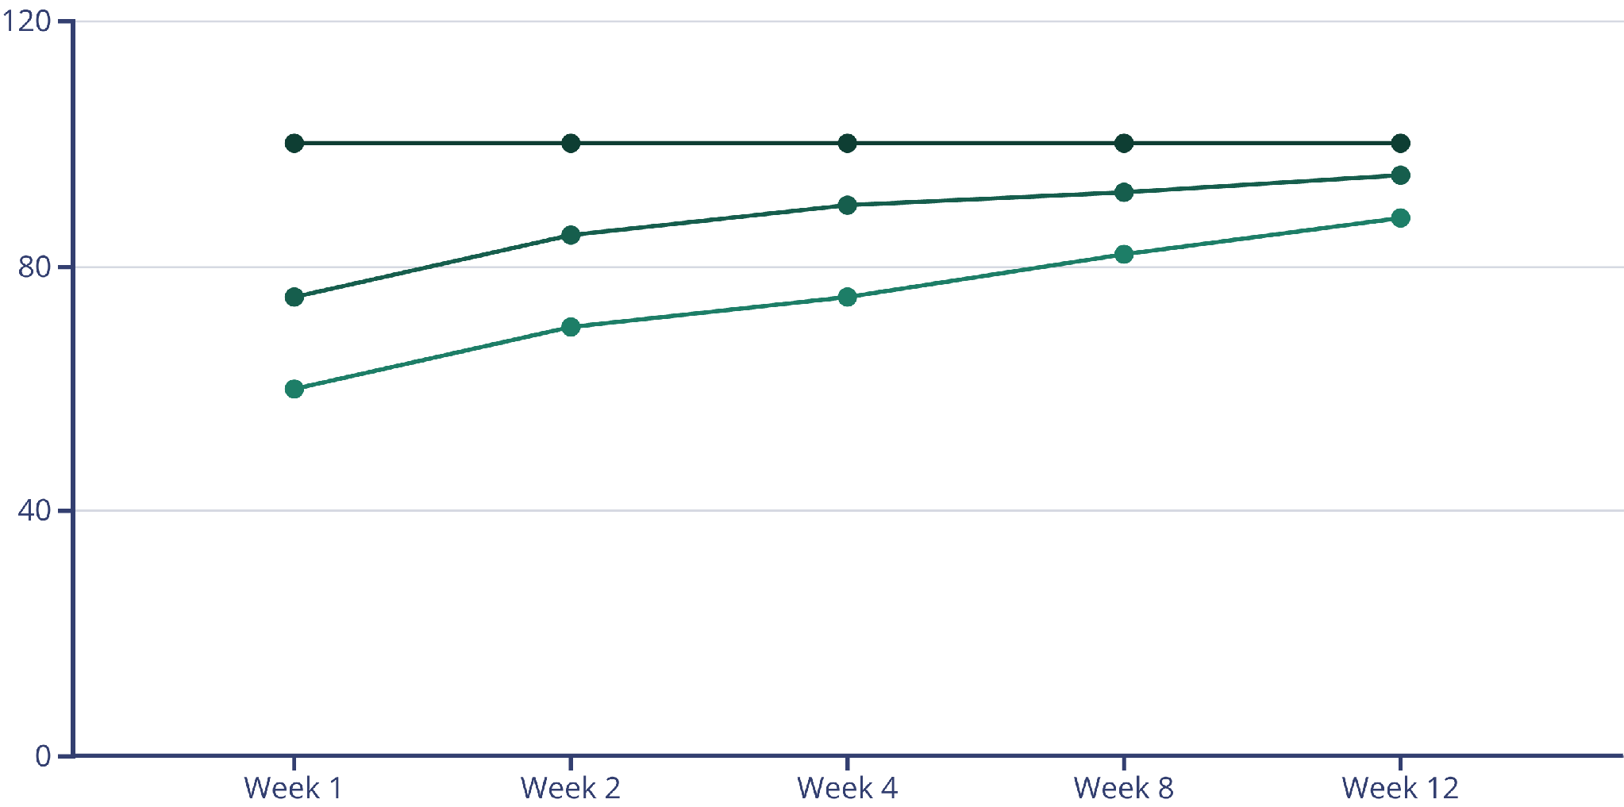
Success Metrics & Evaluation Timeline
Tracking the right metrics at the right time ensures we can identify issues early and celebrate wins. Our evaluation cadence provides actionable insights throughout the pilot and full deployment.
Training Completion Rate
System Adoption Rate
User Proficiency Score
85%
90%
20%
6mo
Target Satisfaction
Active Usage Goal
Efficiency Gain
ROI Timeline
Projected timeframe to achieve positive return on training investment through productivity gains
Minimum acceptable rating for training quality and relevance from participant surveys
Percentage of trained users actively logging in and using core CRM features daily
Expected reduction in loan processing time within 90 days of full adoption
Ready to Transform ABC Bank's Lending Operations
Our comprehensive training solution combines proven adult learning principles, flexible delivery methods, and rigorous evaluation to ensure your CRM deployment succeeds. Let's partner to make this implementation a model for organizational change.

